Slide 1
Four wheel steer Mechanism

Slide 2

Under the guidance of
V.K. Gupta
Professor of Mechanical department IIITDMJ
Himanshu Shekhar Nanda
Assistant Professor ,IIITDMJ

Slide 3
Why Four Wheel Steering Mechanism ?
Ultimate cornering ability. (better than anything we have now)
Smallest turning circle possible.
Better stability of the vehicle.
The intensity of four wheel steering can be adjusted by the driver according to personal preference.

Slide 4
Principles of Four Wheel Steering Mechanism
At the center of gravity of a vehicle, the control function for rear steering can cancel the side slip angle which varies as the running speed is changed.
An instantaneous center of vehicle motion is controlled, employing rear steering. Even though the running speed of the vehicle is changed, the side slip angle remains as it was, if a relation of the position of the instantaneous center of vehicle motion to the vehicle does not change.
Taking account of an instantaneous center of yaw motion will enable us to select how much the side slip angle should be.

Slide 5
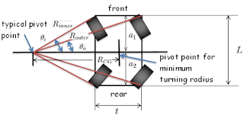
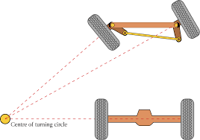

Slide 6
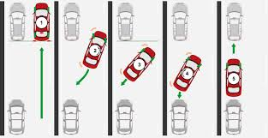
Application
Parallel parking
To be used for space rovers
High speed lane change

Slide 7
PLATFORM OF WOOD OR STEEL
MOTORS(MOST SUITABLE HIGH TORQUE SERVO MOTORS)
GEARS
BICYCLE CHAIN to rotate four wheels simultaneously.
TYRES
METALLIC BARS(STEEL or ALLUMINIUM)to be used in making platform stable.
SOLDERING ROD for wiring of circuit.
GLUE GUN
NUTS / BOLTS / SCREWS
MATERIAL WHICH CAN BE REQUIRE?

Slide 8
Thank you

